Slide 1

Learnings from the design of a pathway model in R Dawn Lee and Darren Burns
Peninsula Technology Assessment Group (PenTAG)
University of Exeter, St Luke’s Campus, Exeter, EX1 2LU
PenTAG Health Technology Assessment | ESMI | University of Exeter
pentag@exeter.ac.uk

Slide 2
Why did we want an independent open-source reference model?
Recommendations and inputs inconsistent in previous TAs
None of the previous TAs considered subsequent therapy appropriately
Treatments have been recommended which in hindsight were not cost-effective
The process for NICE and EAGs was inefficient
Notes:
Both issues – not fit for purpose, inefficient

Slide 3
Lee, D., Burns, D. & Wilson, E. NICE’s Pathways Pilot: Pursuing Good Decision Making in Difficult Circumstances. PharmacoEconomics Open (2024). https://doi.org/10.1007/s41669-024-00490-x https://github.com/nice-digital/NICE-model-repo
The NICE RCC Pathways Pilot Open-Source Model
Developed on behalf of NICE to support a live appraisal (nivo+cabo) – tight timelines!
Ability to look at sequences for future initiatives
PartSA and state transition structures
Time varying hazard-ratios and hazards
Data provided by intervention company and comparators ranging from time to event data inputs to aggregate level data only
Use of RWE for baseline risk
744 possible sequences, up to 14,000 states per sequence, 2080 cycles, 3 populations
No template models to follow
Given complexity and computational requirements R was the logical choice
Notes:
20+ billion computations per set of traces

Slide 4
How does it work?
Efficacy extrapolated for reference treatments per line
Comparator efficacy calculated per line
Adjust for treatment effect waning
Adjust for general population mortality
Account for crossing curves
Produce health state occupancy proportions
Apply costs and benefits
Generate results per sequence
Model inputs loaded from Excel front end and R output files from stats
Possible treatment sequences produced
Weight sequences to generate result per 1L treatment
Automated results output to Word

Slide 5
R, sparse matrices and connecting evidence with outcomes
Using Matrix(), list() and Reduce() and a little-known R trick to build an efficient model engine, even in the face of more than 14,000 health states for 2080 cycles
Prepared by: Darren Burns

Slide 6
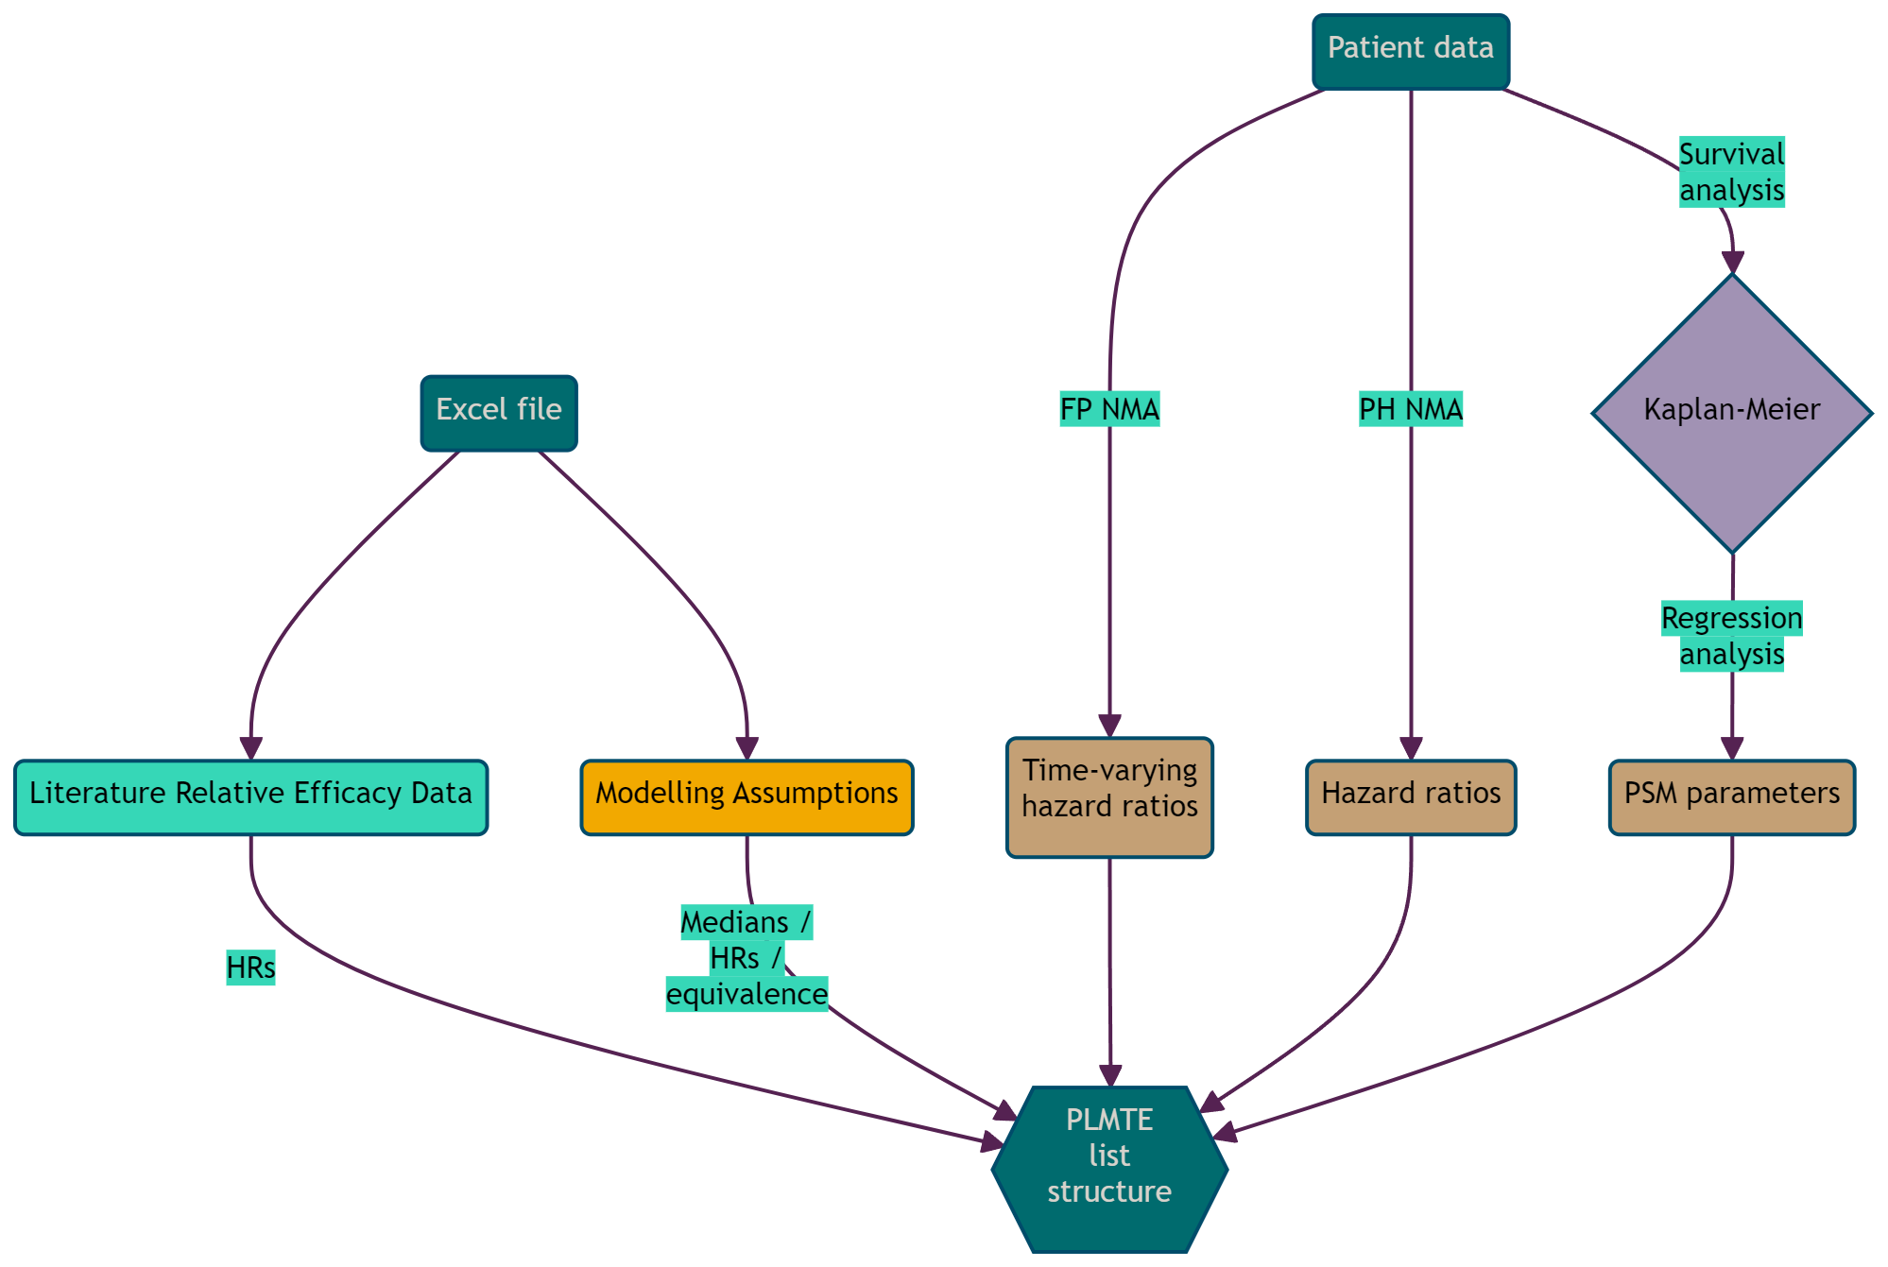
Generalized CE model extrapolation in PATT: information collation
Myriad processes for generating extrapolations for each PLMTE, considering:
Direct extrapolations at any PLMTE
Recursive application of relative efficacy across PLMTEs
Therefore, structure requires potential to link any PLMTE with any other PLMTE for any degree of separation (DoS), without changing any R code.
Issues: Excel is still ESSENTIAL for storing and managing inputs! Shiny interface could help and could provide essential additional validation which we had to do manually, but we had to move fast and change the entire UI repeatedly (minutes not hours, hours not days).
Key: P: Population; T: Trial; M: Molecule; T: Trial; E: Endpoint; HR: Hazard ratio; FP: Fractional polynomial; PH: Proportional hazards; PSM, parametric survival analysis

Slide 7
Generalized CE model propagation in PATT: f_releff_PropNetwork
(Updated) PLMTE list structure
Check degree of separation (DoS)
If DoS=0, enter direct extrapolations for all possible DESTINATIONS for the corresponding parametric choices
For all PLMTEs:
If DoS>0 relative efficacy where origin is populated with an extrapolation
Identify the corresponding extrapolation ORIGIN, if any (if none, move on!)
Apply the relative efficacy stored in this PLMTE space to the ORIGIN survival extrapolation
extraps <- Reduce(
x = 1:dos,
init = network,
accumulate = FALSE,
f = function(prev_network, deg_of_sep) {
if (deg_of_sep == 1) { prev_network_this <- Reduce(
x = 1:nrow(ref_curves),
init = prev_network,
accumulate = FALSE,
f = function(prev, ref_curve_row) {
Go row by row down reference curve table
Assign ORIG = DEST for each ref curve
User settings and parameters → extrapolation
Add e.g. stopping rules etc
}
return(prev_network_this) } else { prev_network_this <- Reduce(
x = 1:nrow(releff),
init = prev_network,
accumulate = FALSE,
f = function(prev, releff_row) {
Go row by row down relative efficacy table
For each DEST, check in ORIG for an extrap
If ORIG ☑ + DEST ☒ + releff ☑, then ORIG → releff = DEST
If not, do nothing
}
return(prev_network_this) }
})
Key: P: Population; T: Trial; M: Molecule; T: Trial; E: Endpoint; HR: Hazard ratio; FP: Fractional polynomial; PH: Proportional hazards

Slide 8
From hundreds of extrapolations to a Markov trace (1)
Starting point: every possible extrapolation from input set and layers of relative efficacy
We need to model every possible treatment pathway as efficiently as possible
We use tunnels. Lots and lots of tunnels…
Patients flow through successive lines of therapy, and we have the extrapolations
We can apply $p_{t}=1 −\frac{s(t)}{s(t−1)}$ as state exit probabilities, and apply some assumptions to get all required TPs
We can apply 𝑝_𝑡=1 −(𝑠(𝑡))/(𝑠(𝑡−1)) as state exit probabilities, and apply some assumptions to get all required TPs
We can put the TPs into matrix M. Note that for 5-line PATT, M has over 14,000 health states (rows & cols)…M is very large!
We know that all patients start in state 1 (on 1L treatment), so we know the initial population vector p = $\left[\begin{matrix}P_{1} & ⋯ & p_{D}\end{matrix}\right]$, where $p_{1}=1,;p_{2…D}=0$ at baseline
We know that all patients start in state 1 (on 1L treatment), so we know the initial population vector p = [■8(𝑃_1&⋯&𝑝_𝐷 )], where 𝑝_1=1,;𝑝_(2…𝐷)=0 at baseline
Factors steering approach:
R is very good at matrix algebra, and is fast when carefully vectorised
The Matrix package is designed specifically for efficiency and sparse matrix multiplication
There is an R “trick” which performs replace-in-place in RAM (i.e., M[coord[,1], coord[,2]] <- coord[,3]), drastically (orders of magnitude) improving performance, especially with 14,000+ square matrices!
Only 2 rows of M ever change once compiled (the first two)

Slide 9
From hundreds of extrapolations to a Markov trace (2)
p%*%M is at least 85% $0×0$, so both p and M are sparse. p%*%M is a VERY bad idea in base R, as is M[1,1] <- p_11; M[1,2] <- p_12. Under the hood R copies the WHOLE matrix every time you do this i.e., extremely slow ☹
p%*%M is at least 85% 0×0, so both p and M are sparse. p%*%M is a VERY bad idea in base R, as is M[1,1] <- p_11; M[1,2] <- p_12. Under the hood R copies the WHOLE matrix every time you do this i.e., extremely slow ☹
Now we have a (very large) transition probability matrix, but it’s a bit fiddly!
M has some key features:
Top two rows change every cycle, but the rest of the matrix is static
Rows 3+ of M are block-diagonal but offset by 1 column starting at cell 3,4. Blocks go in both directions like DT nodes!
Solution: Compiler function, updater function, extrapolator function
Compiler populates sparse matrix M using the PLMTE list (for cycle 0), then splits off the top two rows into a smaller matrix M1 and the “rest” M2
Extrapolator uses Reduce() to repeatedly perform p = p1M1 + p2M2 (after splitting p)
Updater function generates a list of M1 each model cycle
Factors steering approach:
R is very good at matrix algebra, and is fast when carefully vectorised
The Matrix package is designed specifically for efficiency and sparse matrix multiplication
There is an R “trick” which performs replace-in-place in RAM (i.e., M[coord[,1], coord[,2]] <- coord[,3]), drastically (orders of magnitude) improving performance, especially with 14,000+ square matrices!
Only 2 rows of M ever change once compiled (the first two)

Slide 10

Is the model everything it could be?
Accessible?
Code supplied with video explanations, written instructions and calls to walk through for manufacturers
Shiny-front end in the original analysis plan was not funded
Manufacturers struggled to engage with a model in R
Developers struggled with version control in Git
Regularly updated?
There is no resource in place to maintain the model
Unclear how / if future appraisals might use the model
06
01
Maintained?
There is no resource in place to maintain the model now it is live (yet)
Transparent?
Considerably more detail available than for a usual STA model
Intermediate calculations fully presented
Report tables and figures generated from the code
Full documentation for all functions not available but generally well commented
05
02
Flexible?
Model created allows addition / removal of treatments, up to 4 lines of active treatment, PartSA and state transition structures, evaluation of treatments or sequences
BUT there are other functionalities which would be useful to increase flexibility (flexible survival analysis, different utility and resource use application, allowing use of TPP, more generic appearance etc…)
04
03
Quality controlled?
Quality control conducted internally and by the DSU
DSU found no major errors
Unit testing not in place for the majority of functions

Slide 11
Where next? HEverse: Forking package structure with resources packages
Each individual model used for a HTA could be rolled into its own R package (contained within a meta-package) that takes resources from previous models during construction.
For the example, if we had a meta-package called NICE, we would have packages like this:
NICEResources – common functions for modelling, plus NICE methods guidance on adapting and building one’s own functions specific to a NICE HTA model
NICETATemplates – a package containing functions which generate general folder structures, layouts etc for modelling
NICEReports – a package containing templates of the rmarkdown/bookdown templates to be used for automated reporting.
NICETAXXX – CE model for NICE TA XXX
NICETAXXX – CE model for NICE TA XXX
Next step to get there: joint application for grant funding with Bristol, Sheffield, York and UCL including template gold-standard model implementations in a set of key disease areas. Get involved!

